Slide 1
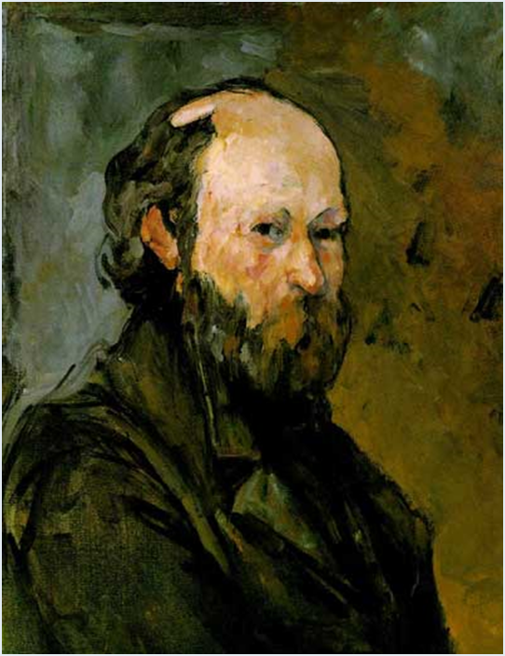
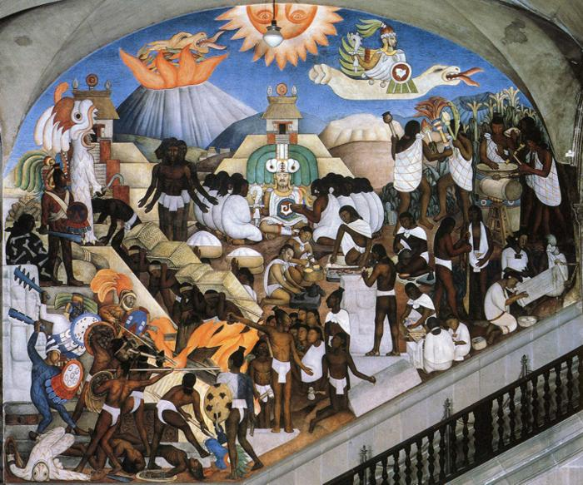
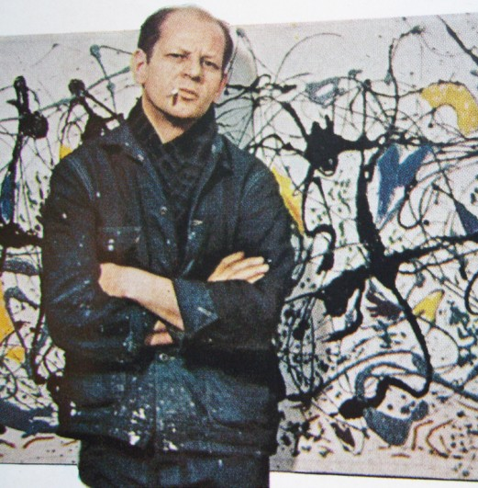
Modern Art 109 From late 19th century to mid-20th Century
(left) Paul Cézanne, Self Portrait, 1878-80 (middle) Diego Rivera, The History of Mexico - The Ancient Indian World. 1929-35. Fresco. North wall, National Palace, Mexico City, Mexico.
(right) Jackson Pollock (American ‘Action’ painter, 1949 Life magazine photo for article, “Is He the Greatest Living Painter in the United States?”

Slide 2
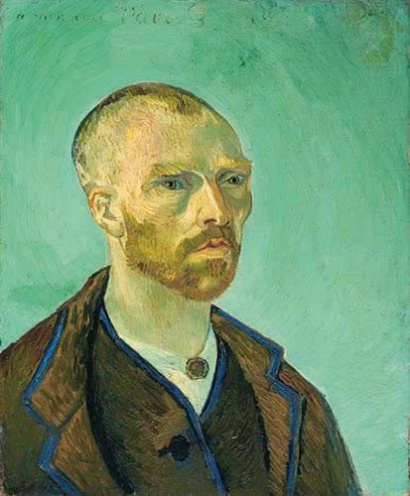
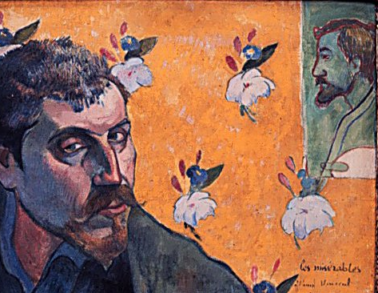
Vincent Van Gogh, Dutch Post-Impressionist Painter, 1853-1890 (37 years) Paul Gauguin, French Post-Impressionist Painter, 1848-1903 (55 years)
Vincent Van Gogh, Self-Portrait
Dedicated to Paul Gauguin, 1888
(artist is 35 years old)
Paul Gauguin, Self Portrait Dedicated to
Vincent, Les Misérables, 1888 (artist is 40 years old)
Self-defined artistes maudits – self-exiled from conventional urban, middle-class modernity
scorned for their non-conformism. The “heroic” avant-garde

Slide 3
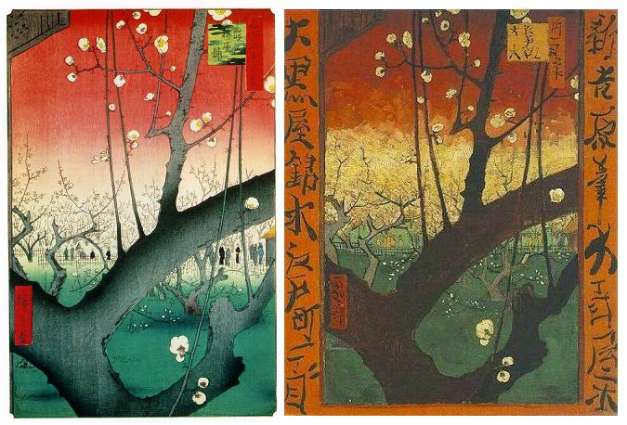
TOKYO-PARIS – Japanism and Occidentalism (left) Ando Hiroshige, Kameido Ume (Japanese apricot) Garden, woodcut, ink on paper, 1857, from the series, One Hundred Famous Views of Edo (right) Vincent Van Gogh, Plum Tree in Bloom (after Hiroshige), oil on canvas,1887

Slide 4
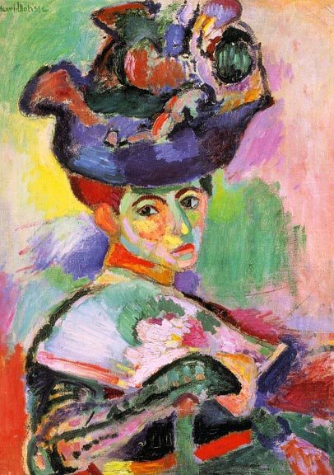
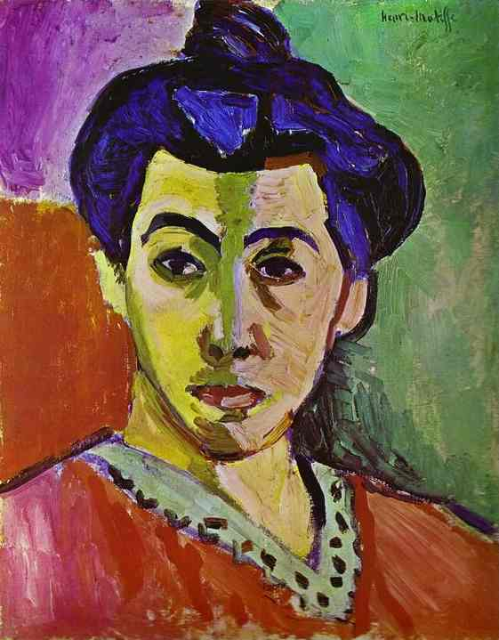
FAUVISM (left) Henri Matisse, Woman with a Hat (Madame Matisse), 1904-5 (below) Matisse, The Green Stripe (Madame Matisse), 1905

Slide 5
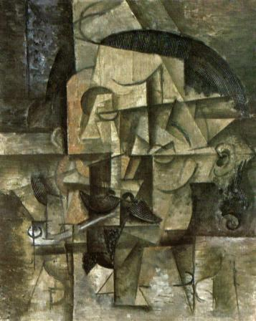
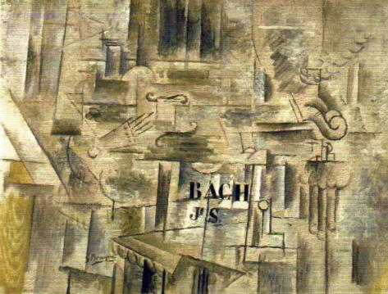
CUBISM (left) Georges Braque, French, Homage to J. S. Bach, oil on canvas, 21 x 28”, Céret, Winter 1911-12. First use of trompe l’oeil wood grain created with housepainter’s combs (right) Pablo Picasso, Spanish,The Poet, summer 1912, oil on canvas, 23 x 19” Picasso, instructed by Braque, uses housepainter’s combs for the hair, adding an element of wit.
Almost every evening, either I went to Braque’s studio or Braque came to mine. Each of us had to see what the other had done during the day.
- Picasso (recalling 1910-12)

Slide 6
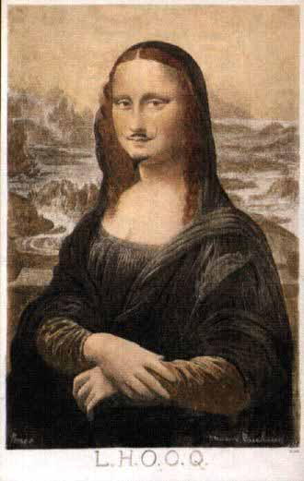
Duchamp, L.H.O.O.Q, 1919, reproduction of the Mona Lisa with hand drawn mustache and goatee, and added iconoclastic inscription. “Readymade Assisted”

Slide 7
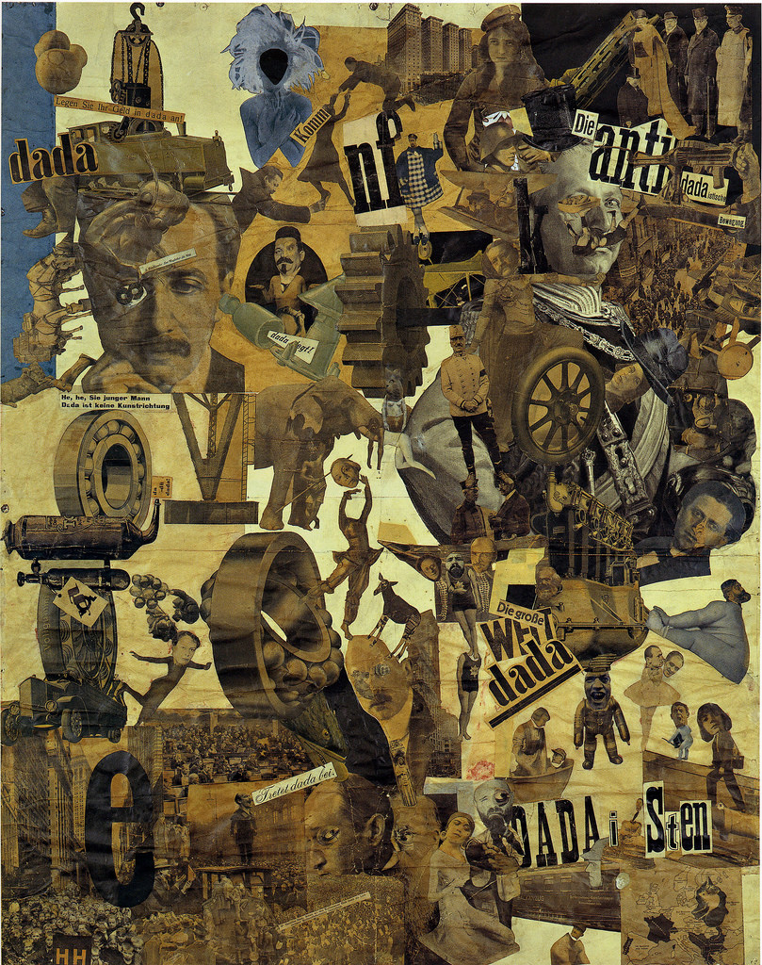
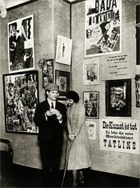
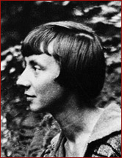
Hannah Höch (German, 1889 -1978), Cut With the Kitchen Knife Dada through the Last Weimar Beer Belly Cultural Epoch of Germany, 1919 (right, below) Raoul Hausmann & Hannah Höch at 1920 Berlin Dada Fair
Höch in 1917

Slide 8
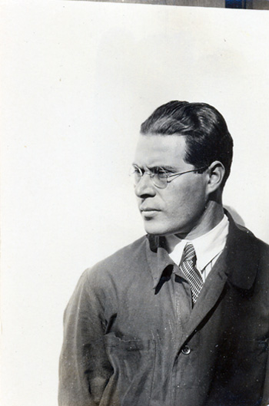
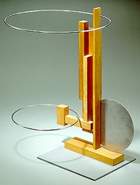
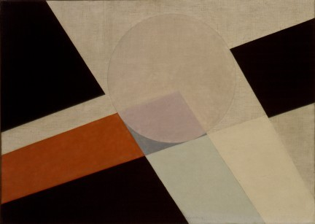
László Moholy-Nagy (Hungarian photographer, typographer, sculptor, painter, printmaker, and industrial designer, 1895-1946) BAUHAUS (left) Balance study, 1924, wood and metal (center) László Moholy-Nagy and Lucia Moholy, Portrait of Moholy-Nagy, 1932 (right) Moholy-Nagy, AXXV, oil on canvas,1926
Moholy-Nagy, Bauhaus master
replaced Johannes Itten as the
instructor of the preliminary course
in 1923

Slide 9
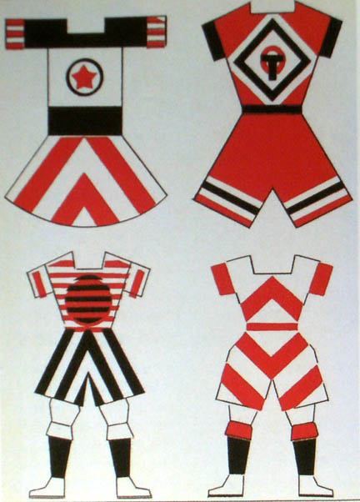
Varvara Stepanova (Russian, 1894-1958) with her designs for sportswear, both 1923 The “New Woman” and production (Constructivist) aesthetics

Slide 10
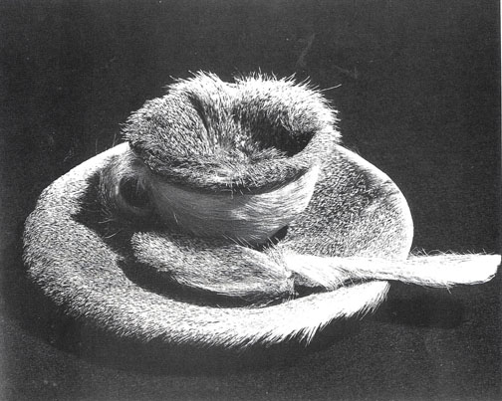
Meret Oppenheim (German, 1913-1985), Object (Luncheon in Fur) 1936, fur covered cup, saucer, spoon, two views, Surrealism
1936 photo of Object by Dora Maar

Slide 11
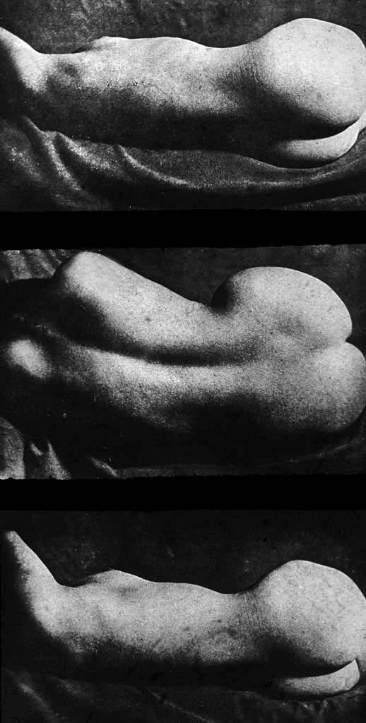
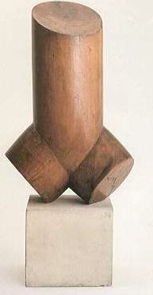
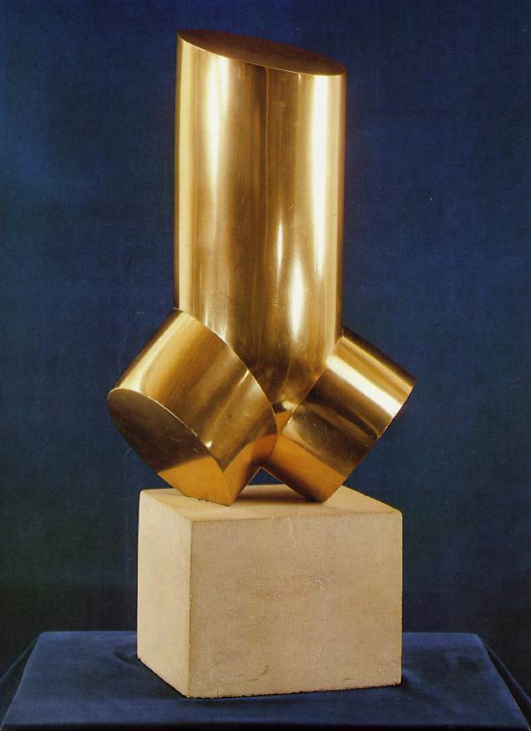
Man Ray, Minotaur, 1933
Surrealist “formlessness”:
challenging the duality of sex
Brassai, Nudes, 1933
Phallus-female torso
Constantin Brancusi, Torso, 1924 & 1926

Slide 12
Modern Art in Africa, Asia, and Latin America: An Introduction to Global Modernisms
“. . . .every Museum of Modern Art in the United States and Europe should be required, in the spirit of truth in advertising, to change its name to Museum of Western Modernism until it has earned the right to do otherwise.” Holland Cotter NYTimes, 2012

Slide 13
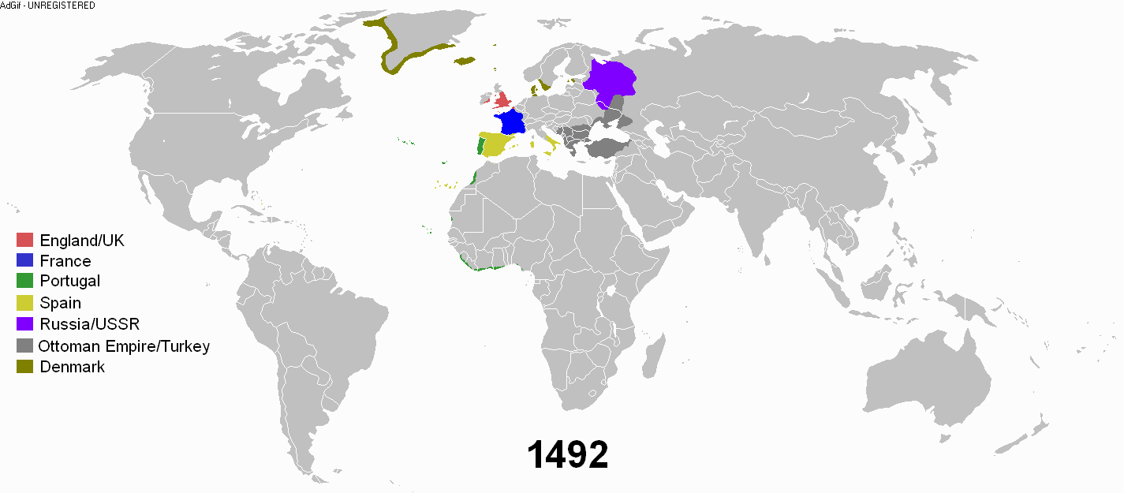
Open link below to follow the geographical history
of European colonialism, 1492-2008
http://upload.wikimedia.org/wikipedia/commons/8/89/Colonisation2.gif

Slide 14
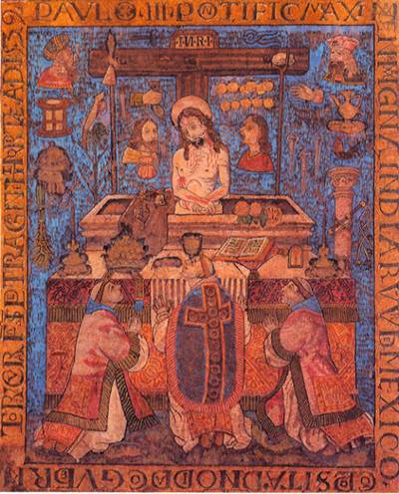
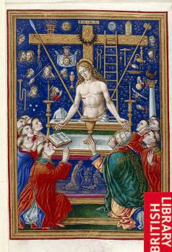
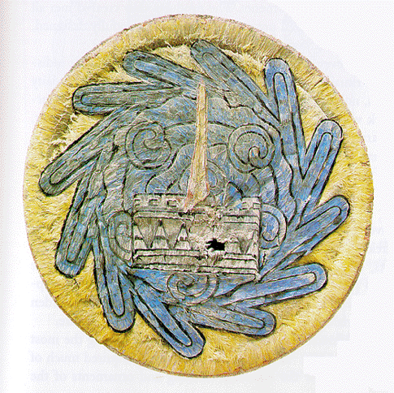
(left) Unknown Aztec artist, The Miraculous Mass of Saint Gregory, Mexico City, 1539, feather on wood, 26 x 22,” commissioned by the first colonial governor of Tenochtitlan (Mexico City) as a gift for Pope Paul III (center right) Giovanni Pietro Birago, Mass of Saint Gregory, painting, Milan, c. 1490 , typical source for feather painting (right) Pre-Conquest Aztec feathered shield, c. 1500 CE

Slide 15
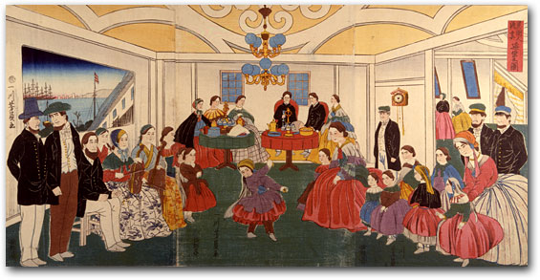
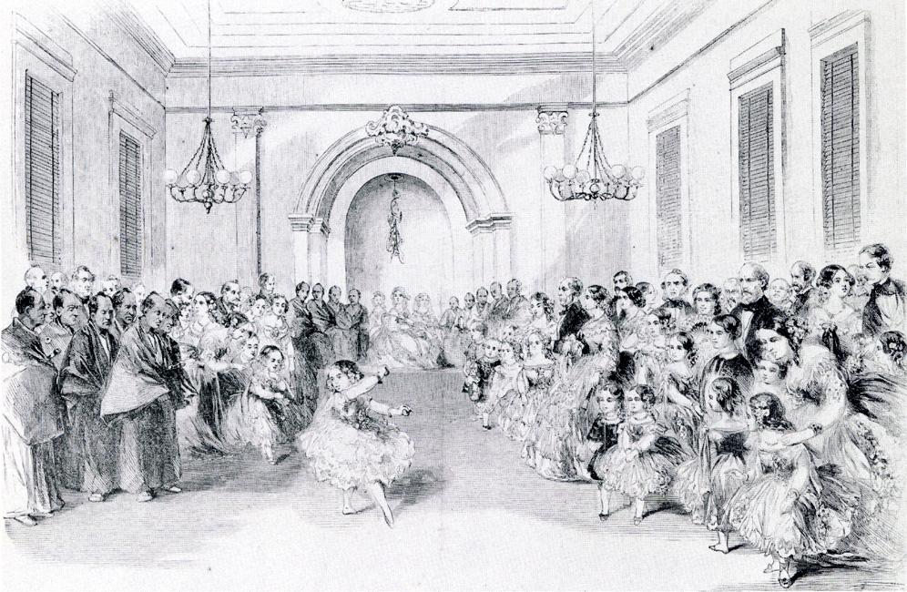
Yoshikazu, Picture of Foreigners Enjoying a Banquet, December 1860, Yokohama, color woodblock
Children dance at the May Festival Ball given in honor of the Japanese ambassadors
Frank Leslie’s Illustrated Newspaper, June 6, 1860

Slide 16
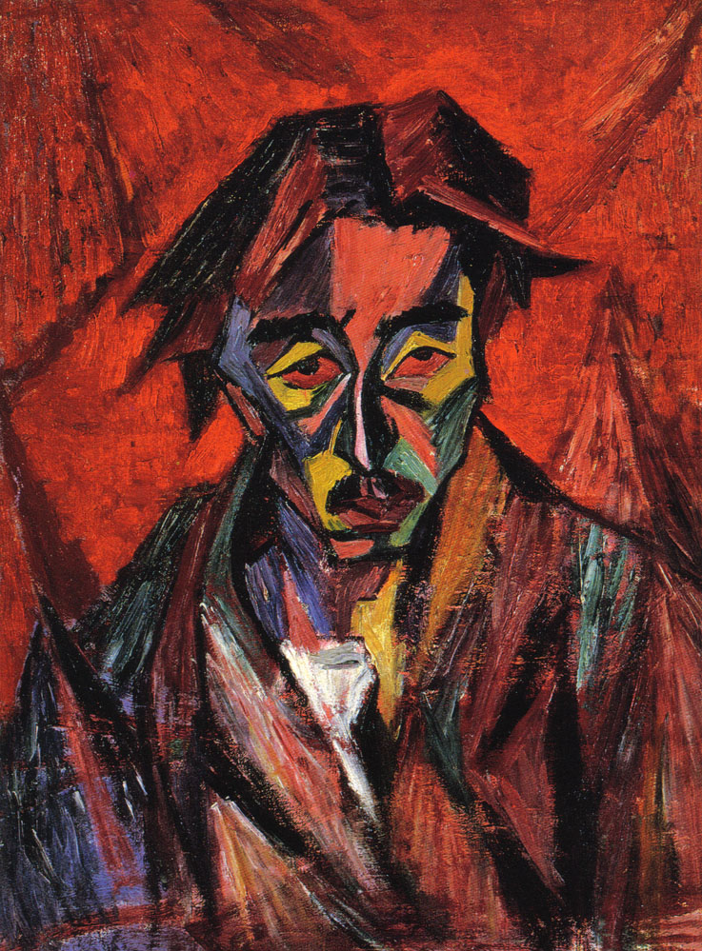
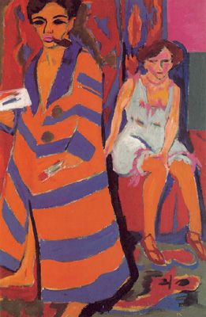
(left) Yorozu Tetsugoro, Self Portrait with Red Eyes, oil on canvas, 1912 – Expressionist / Cubist / Futurist / Global avant-garde modernism (right) Ernst Ludwig Kirchner (German Expressionist, 1880-1938), Self Portrait with Model, oil on canvas, 1910

Slide 17
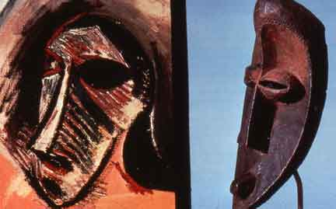
Transformative influence of African tribal sculpture Picasso’s epiphany in June 1907 at the ethnographic museum in Paris Georges Braque: “It is as if someone had drunk kerosene to spit fire."
“My first exorcism painting….
For me the masks were not just sculptures. They were magical objects...intercessors...against everything - against unknown threatening spirits....They were weapons . . . to keep people from being ruled by spirits. To help them free themselves. . . . If we give a form to these spirits we become free."

Slide 18
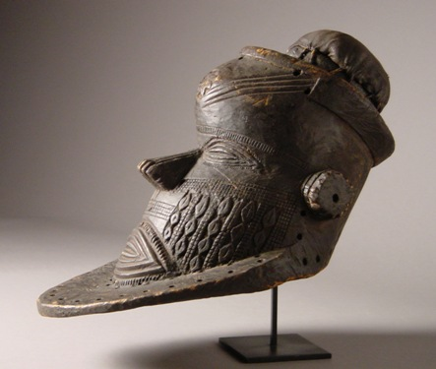
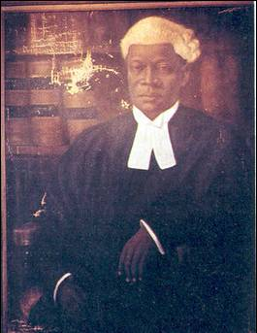
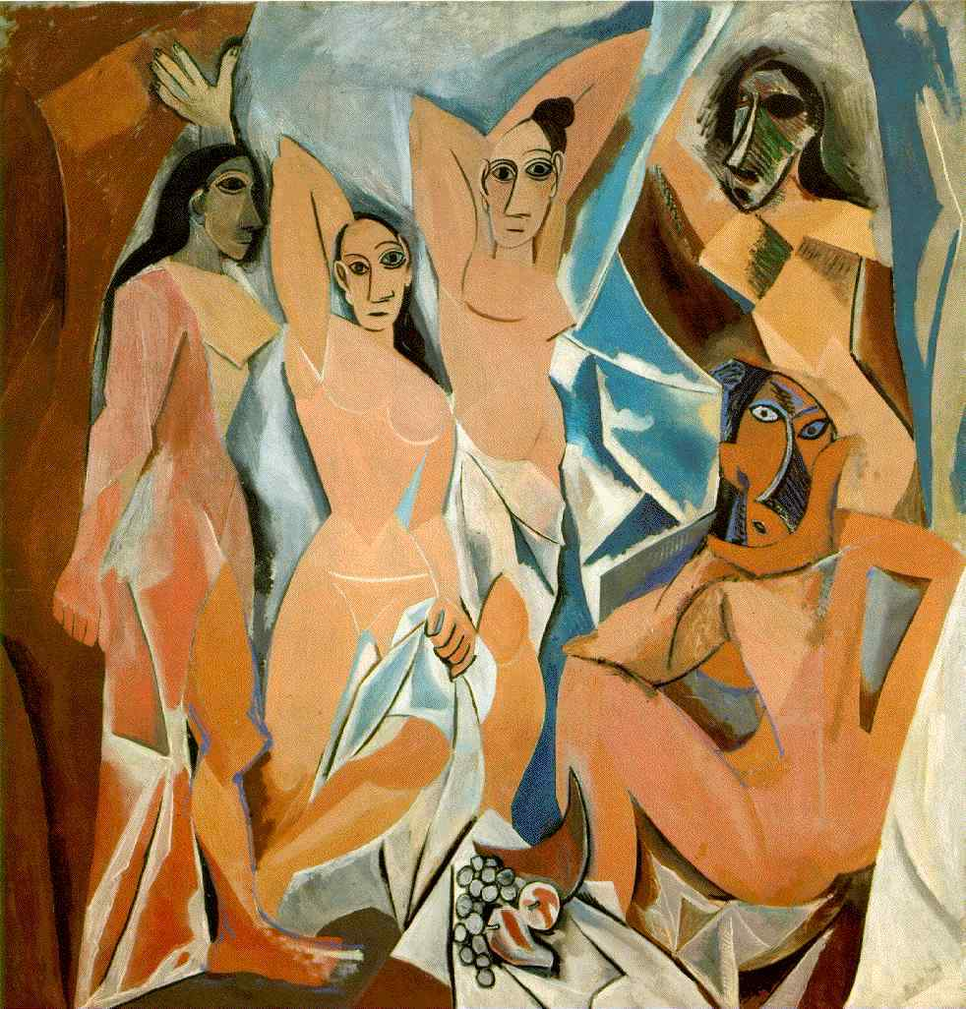
(left) Aina Onabolu (Yoruba-Nigerian, 1882-1963), Portrait of a Lawyer, oil on canvas, 1910 (right) Egungun Mask, unknown Yoruba carver, Nigeria, late 19th/early 20th century Picasso, Les Demoiselles d’Avignon, 1907, icon of Western avant-garde painting

Slide 19
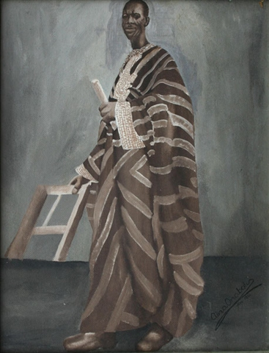
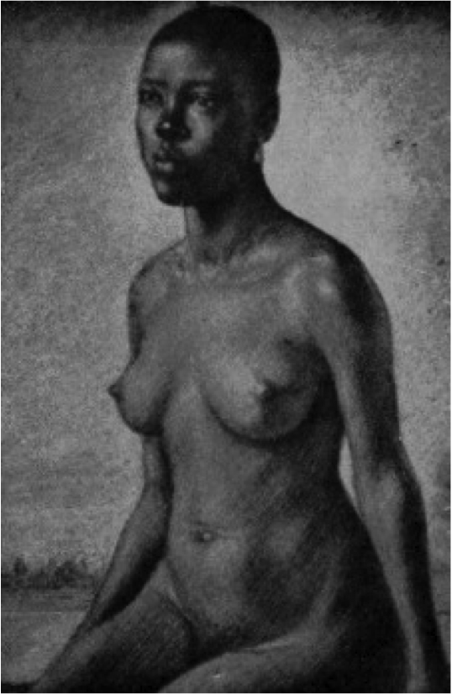
(left) Aina Onabolu, Portrait of a Man (Self Portrait?), oil on canvas, 1954 (right) Onabolu, Nude Study, drawing, 1920(?)

Slide 20
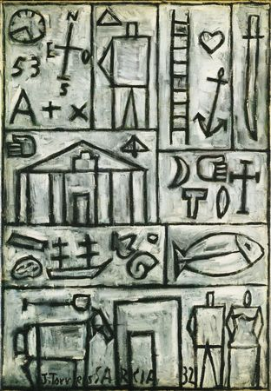
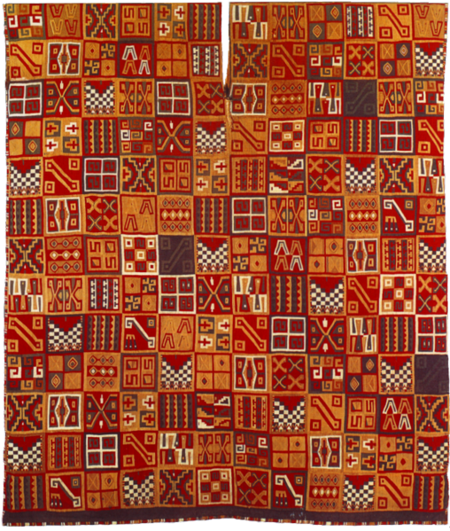
The 20th century avant-garde style and theory of Joaquín Torres García, Universal Constructivism, was influenced by Andean pre-conquest art based on geometric patterns. Compare Inca woven tunic (left), c. 1476-1534 with Torres Garcia, Composition, 1932 (right)

Slide 21
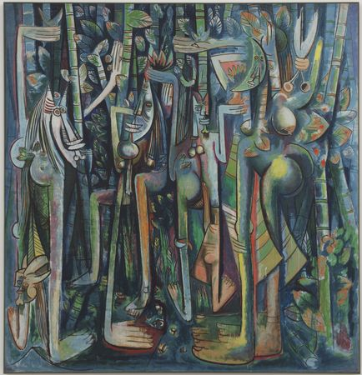
Wifredo Lam (Cuban-born French Painter, 1902-1982), The Jungle, 1943 gouache on paper mounted on canvas, 94 1/4 x 90 1/2“ “. . .beings in passage from a vegetal state to that of an animal still charged with vestiges of the forest” - Wifredo Lam
Strategy of Re-appropriation

